Slide 1
DOELAP Assessor Training Assessment Preparation
Idaho Falls, ID
September 2023

Slide 2
Prepare for the Assessment
Good planning maximizes the effectiveness of the assessment
“eliminate the element of surprise”
Planning is critical to the success of the assessment
Communication between assessment team members and the program to be assessed enhances both successful planning and eliminates the element of surprise
The DOELAP Coordinator or STM will send assessment materials and may provide a link for the assessment materials.

Slide 3
Assessment Materials
Site DOELAP application
Quality Assurance Plan (QAP) submitted with the application
the QAP is also available from the link in question 11 on the application
Performance Testing results for the Test Session
Results may be from the previous test session, e.g. Landauer tests in 23-A, the site applies in 23-B
Previous onsite assessment in PDF and Word file formats
the Word file is converted (with errors) from the PDF file… use with caution

Slide 4
Assessment Materials
corrective action plan from the previous onsite assessment
Vendor CAP?
a packet of assessor files that will be helpful for the onsite assessment
Next slide will list the files
additional documents or messages that may be pertinent to the site being assessed or to the implementation of the DOELAP standards

Slide 5
Assessment Files
Department of Energy's RESL

Slide 6
Assessment Checklist

Slide 7
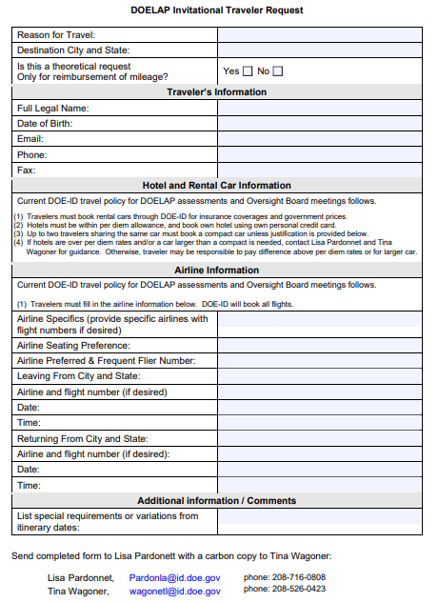
DOELAP Invitational Traveler Request

Slide 8
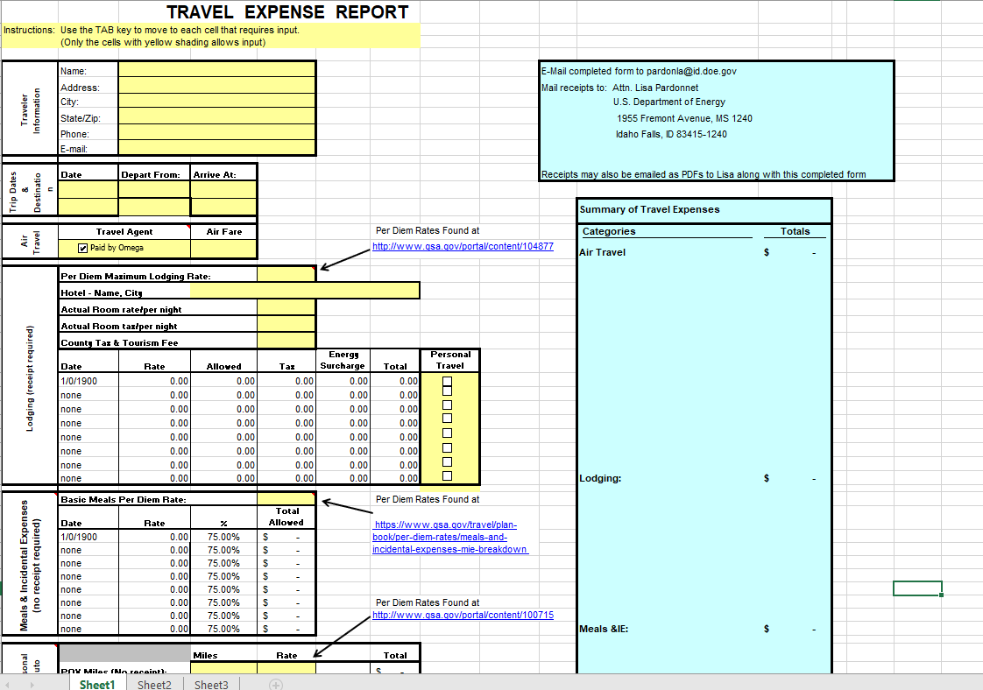
DOELAP Travel Expense Report

Slide 9
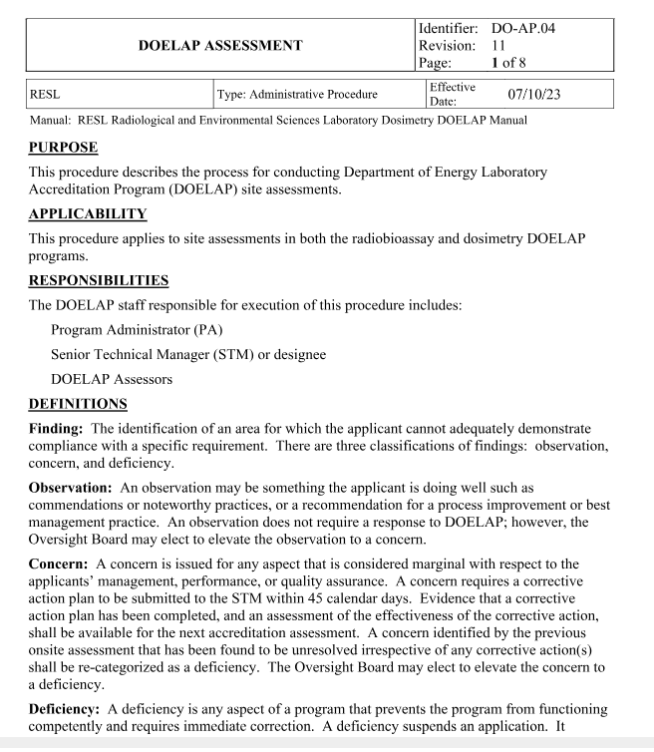
DOELAP Assessment procedure

Slide 10
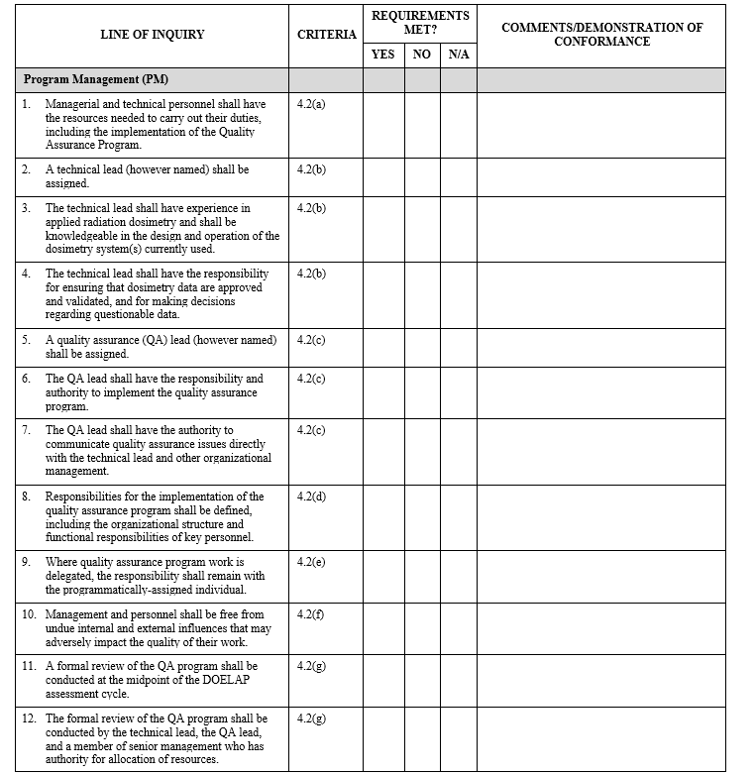
Assessment Checklist

Slide 11
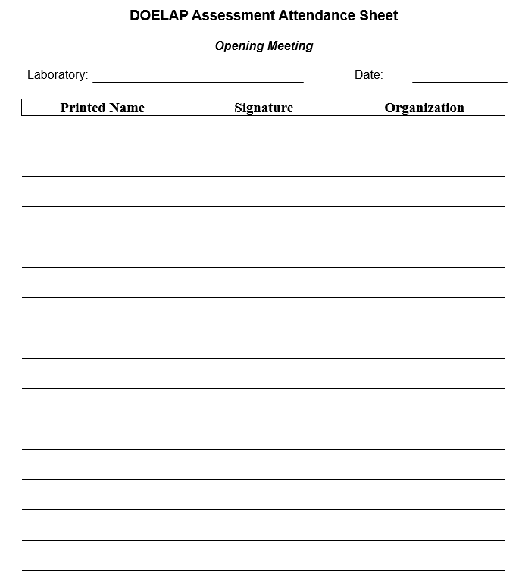
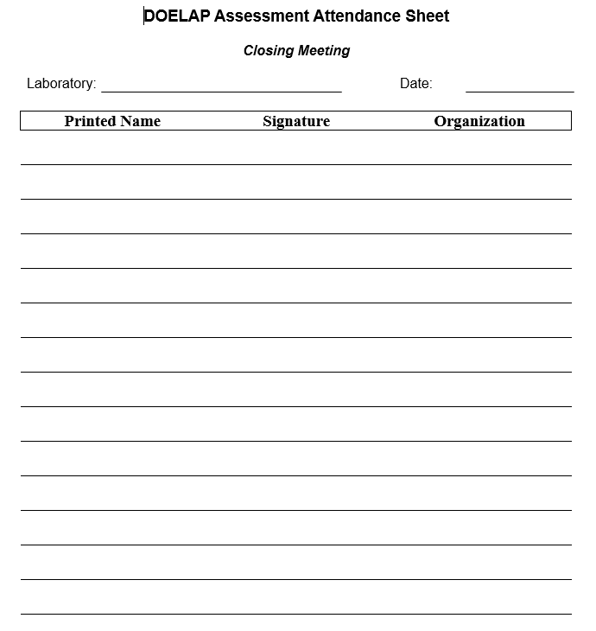
Meeting Attendance Sheets

Slide 12
Assessor Report
Previous Assessment Report
Blank Assessment Report
If using the previous assessment report make sure to change the name in the instructions to the field office. The field office should forward the Site’s response with a cover letter indicating concurrence to:
Steve Bohrer, Senior Technical Manager for DOELAP
Radiological and Environmental Sciences Laboratory
U.S. Department of Energy, Idaho Operations Office
1955 Fremont Ave., MS 2112
Idaho Falls, Idaho 83415-2112
bohrerse@id.doe.gov
Change the name from Guy Backstrom

Slide 13
DOELAP Questionnaires
Found at RESL external website:
https://www.id.energy.gov/resl/doelap/doelap.html
DOELAP Questionnaire
Dosimetry Performance Test Questionnaire
Radiobioassay Performance Test Questionnaire
Program Assessment Questionnaire
Assessor Evaluation
Encourage sites to provide feedback to DOELAP through the questionnaires

Slide 14
Assessment Team Lead Duties
The Assessment Team Lead:
Coordinates the assessment scheduling.
Work with the DOELAP Coordinator or STM for timing.
Submission of corrective action plans before OSB.
Notify DOELAP Coordinator or STM of the schedule.
Coordinates the dissemination of supporting documentation.
Assigns assessment duties.
Conducts the opening and closing meetings.
Coordinates the distribution of assessment documentation.

Slide 15
Assessment Team Lead Duties
Team Lead works with site to arrange:
Lodging
Map
Security Clearances
Site resources (computers, printers, staging room)
Scheduling opening meeting
Interested Management
Site staff (radiobioassay, dosimetry, quality assurance)
DOE Field/Area Office representative

Slide 16
Assessment Team Lead Duties
Team Lead:
Discusses preliminary findings with other assessor after initial review of documents.
May draft preliminary report before assessment.
Incomplete or non-compliant items.
Reduce element of surprise

Slide 17
RESL-DOELAP Public Website
https://www.id.energy.gov/resl/doelap/doelap.html

Slide 18
Questions?

